Slide 1
Statistics in Sports: Football (Soccer) Overview
Zachary Binney, PhD MPH
Oxford college of emory university
Fall 2021

Slide 2
Disclosure
Not a soccer analytics guy
Incomplete, may not even focus on most important current topics

Slide 3
Roadmap
1. Intro and Types of Soccer Data
Events vs. Tracking
2. Expected Goals (xG) Models
3. Beyond Shots
4. Player Evaluation
Radar Charts

Slide 4
Intro and Types of Soccer Data

Slide 5

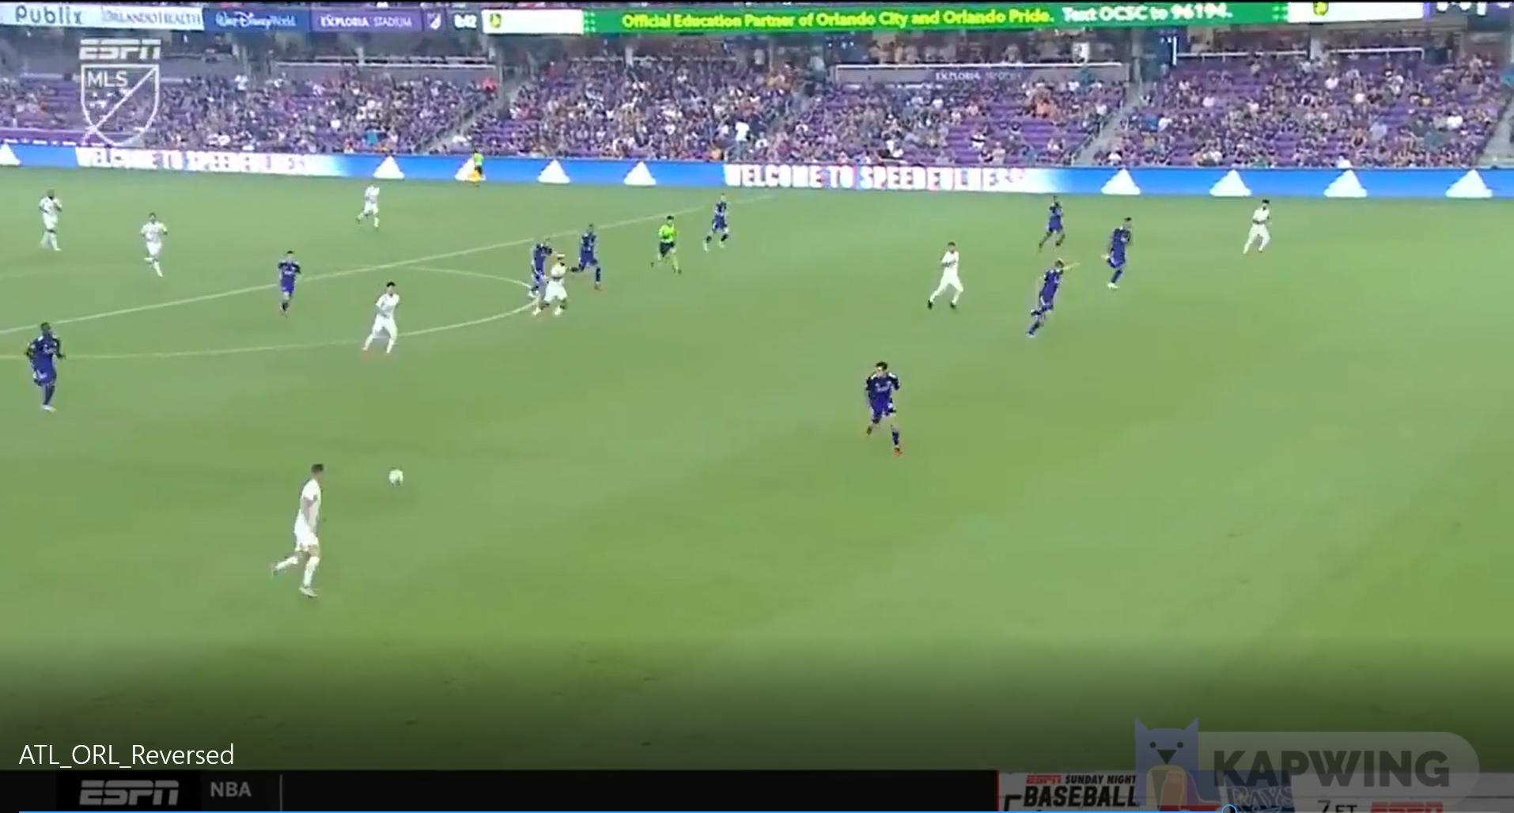
Intro to Soccer Analytics
Let’s watch a goal…
Highlights from Atlanta United-Orlando City FC match, October 2021
Video in lecture folder

Slide 6

Intro to Soccer Analytics
Let’s watch Atlanta United’s first match and first goal ever (!)
2017 vs. NY Red Bull, start around 26:00
How might you break this down into data a computer could analyze?

Slide 7
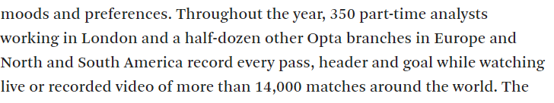
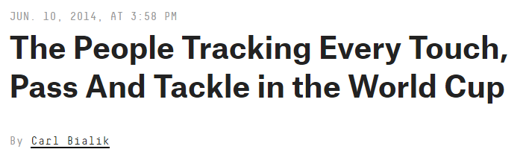
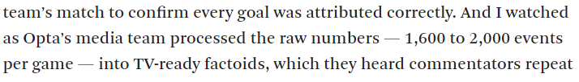
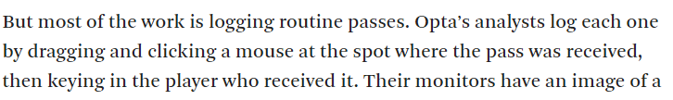
Intro to Soccer Analytics
What if you paused every time something “interesting” or “noteworthy” happened, and logged that?
Events Data
Source: https://fivethirtyeight.com/features/the-people-tracking-every-touch-pass-and-tackle-in-the-world-cup/

Slide 8
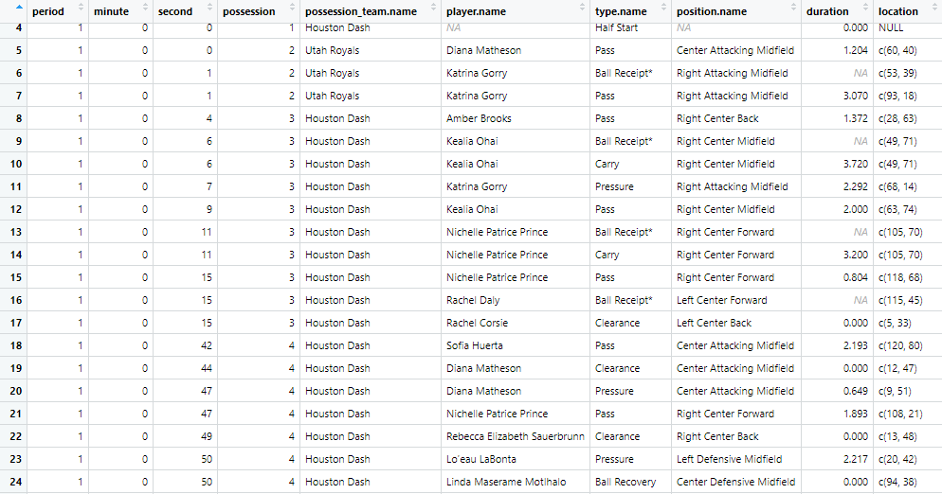
Intro to Soccer Analytics
Events Data example: Statsbomb (105 variables)
Source: StatsBombR package

Slide 9
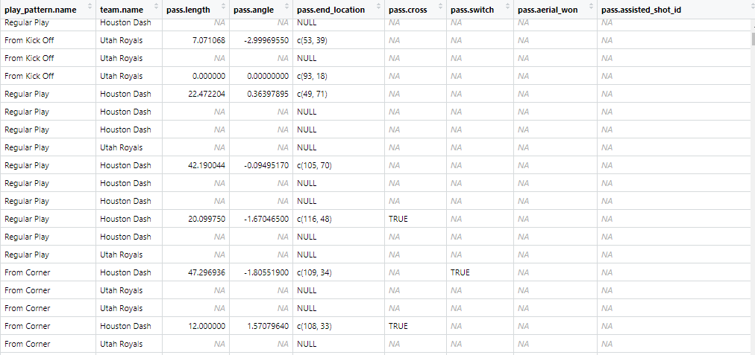
Intro to Soccer Analytics
Events Data example: Statsbomb (105 variables)
Source: StatsBombR package

Slide 10
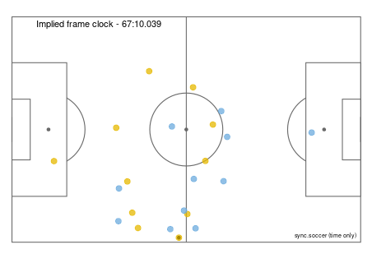
Events vs. Tracking Data
Events Data is distinct from and simpler than…
Tracking Data, which is similar to that in (American) football and comes from GPS chips, RFID tags, and/or cameras tracking X-Y location, speed, and direction of every player and ball multiple times per second
Source: https://kwiatkowski.io/sync.soccer

Slide 11
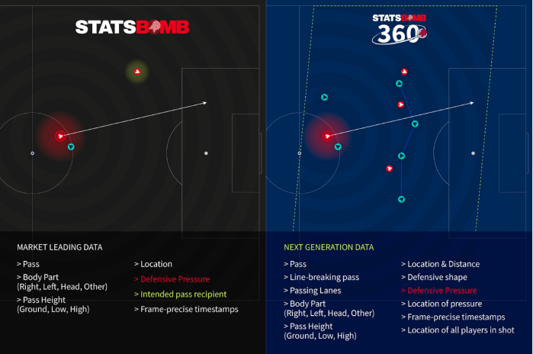
Middle Ground?
Context allows for better assessment of decision-making (e.g. was a better passing lane open, did a pass beat the defense’s line, etc.)
Tracking data can grant even more (what happens between events), but…
Requires tech + data investments
Voluminous and unwieldy
Have to figure out value and how to analyze
Source: https://fivethirtyeight.com/features/soccer-is-learning-to-see-the-whole-game/

Slide 12
Expected Goal (xG) Models

Slide 13
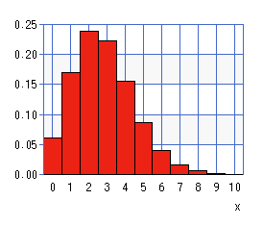
xG Models
How do you win a soccer match?
Problem: (actual) goals are rare, noisy
Poisson distribution with mean of 2.8 goals (roughly Norwich City, 2021/22):
To reduce noise, instead of how a team did look at how they should have done
Source: https://keisan.casio.com/exec/system/1180573180

Slide 14
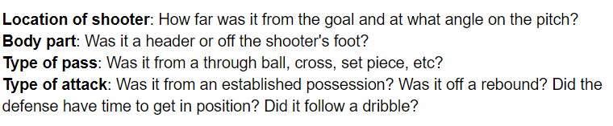
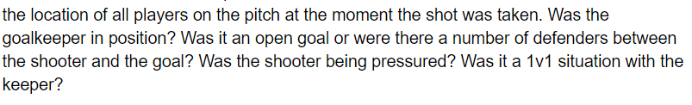
xG Models
Expected Goals (xG) Models. Based on:
Average result (% of goals that went in) in similar situations → xG for that shot
What method do you think is (or could be) used to estimate xG values?
How do you think each of these affects xG?
Source: https://fbref.com/en/expected-goals-model-explained/

Slide 15
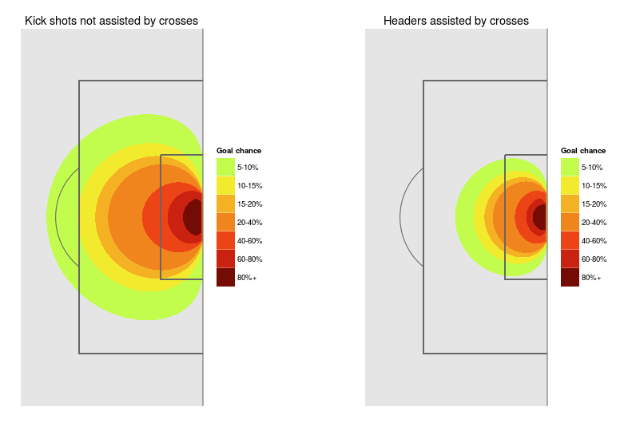
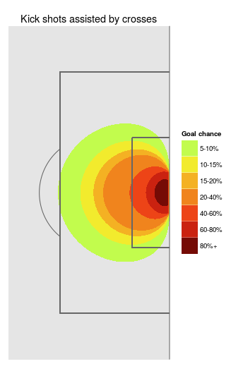
xG Models: Location
xG models and position on pitch
Source: https://statsbomb.com/2016/04/explaining-and-training-shot-quality/

Slide 16
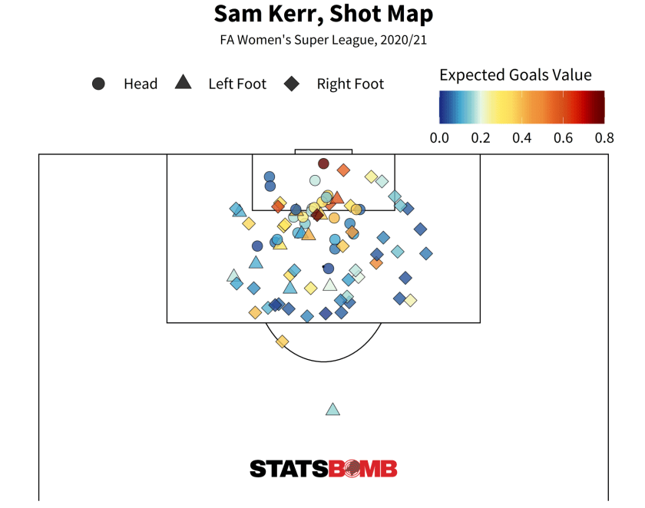
xG Models: Uses
xG model uses
Source: https://statsbomb.com/2021/10/statsbomb-release-free-2020-21-fa-womens-super-league-data-updated-r-guide/

Slide 17
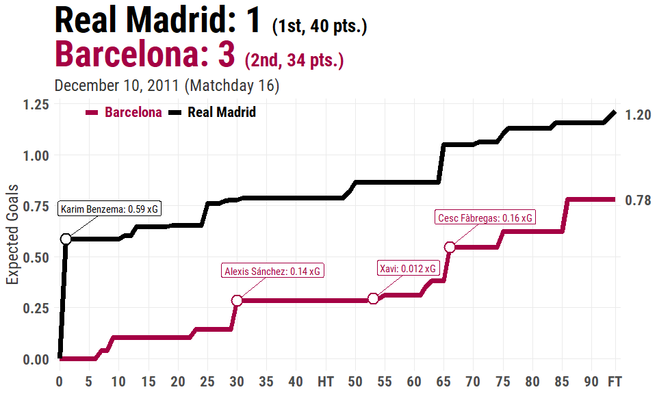
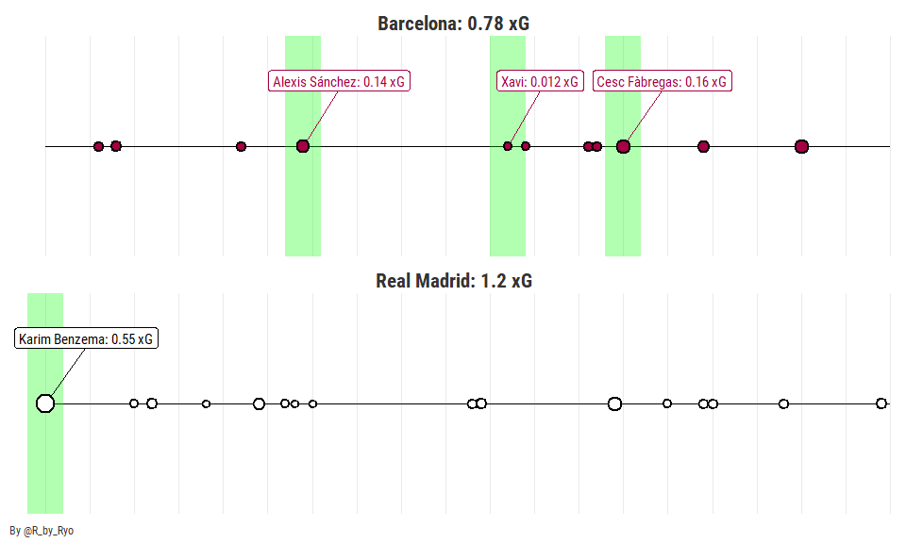
xG Models: Uses
xG model uses
Source: StatsBomb, https://ryo-n7.github.io/2019-08-21-visualize-soccer-statsbomb-part-1//

Slide 18
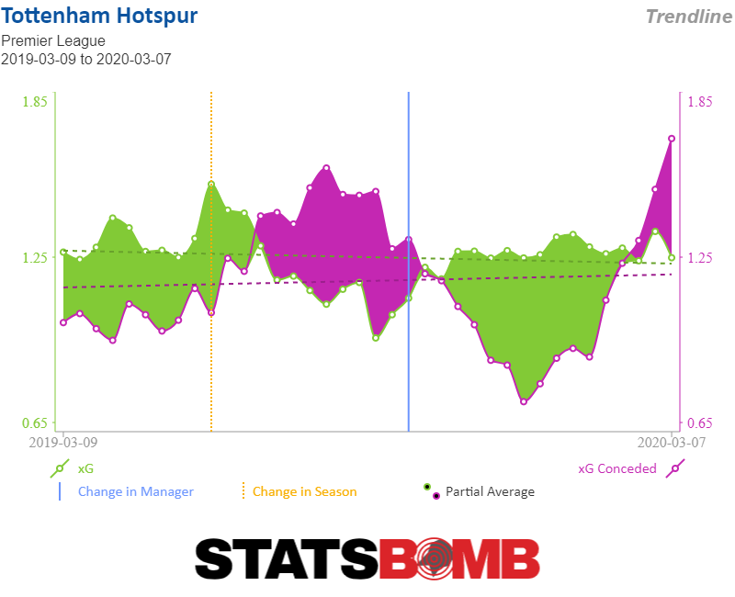
xG Models: Uses
xG model uses
Source: https://fbref.com/en/statsbomb/

Slide 19
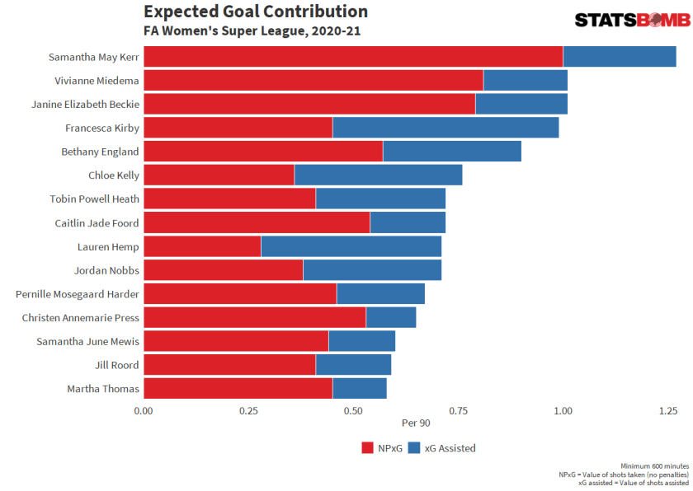
xG Models: Uses
Can add in expected assists (xA) for more holistic picture
Source: https://statsbomb.com/2021/10/statsbomb-release-free-2020-21-fa-womens-super-league-data-updated-r-guide/

Slide 20
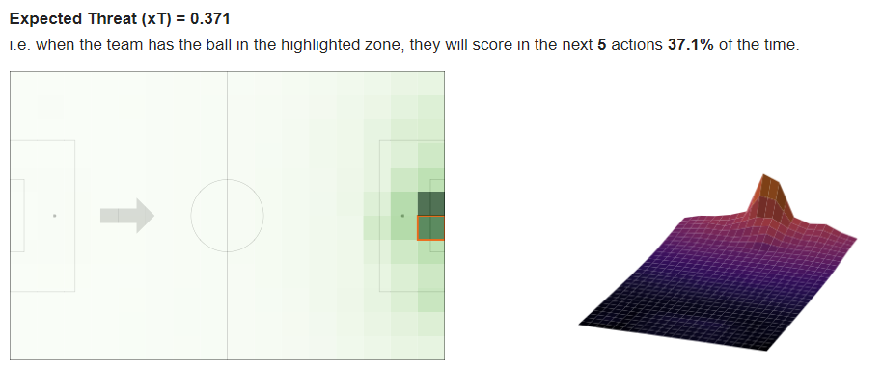
xG Models: Extensions
Related model: expected thread (xT)
Source: https://karun.in/blog/expected-threat.html

Slide 21
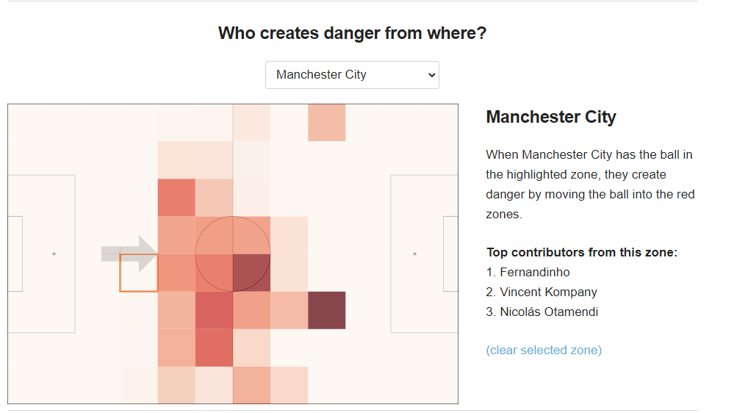
xG Models: Extensions
Related model: expected thread (xT). Take a step back…
Source: https://karun.in/blog/expected-threat.html

Slide 22
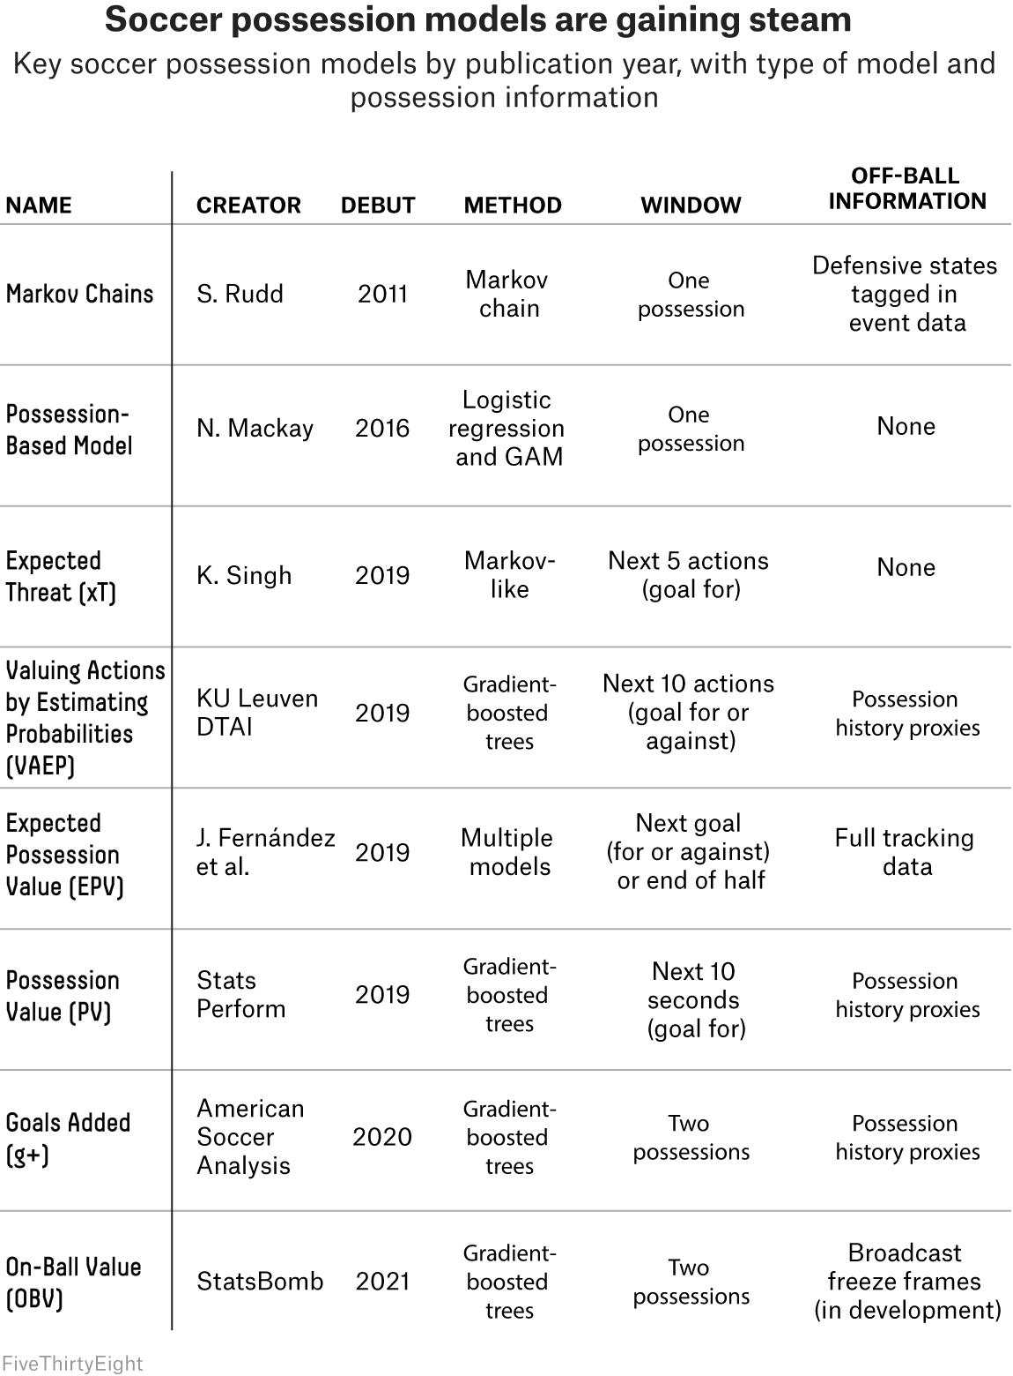
xG Models: Extensions
Ultimate goal: possession value to be able to estimate value of individual actions on the field regardless of position
Can you link this quest with any concepts we’ve seen in other sports?
Source: https://fivethirtyeight.com/features/possession-is-the-puzzle-of-soccer-analytics-these-models-are-trying-to-solve-it/

Slide 23
Beyond Shots

Slide 24
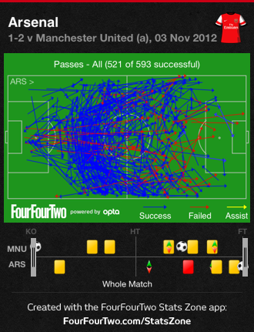
Passing
“Raw” passing data map
Source: https://theshortfuse.sbnation.com/2012/11/3/3595432/manchester-united-v-arsenal-stats-premier-league-2012/

Slide 25
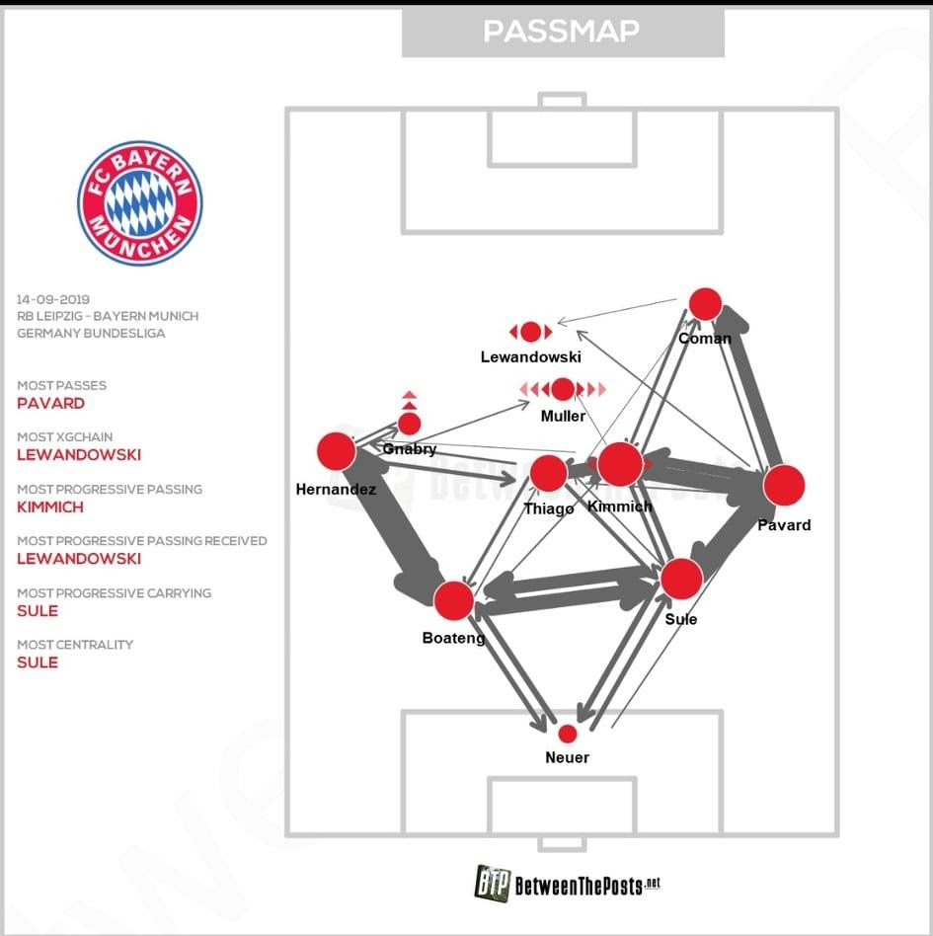
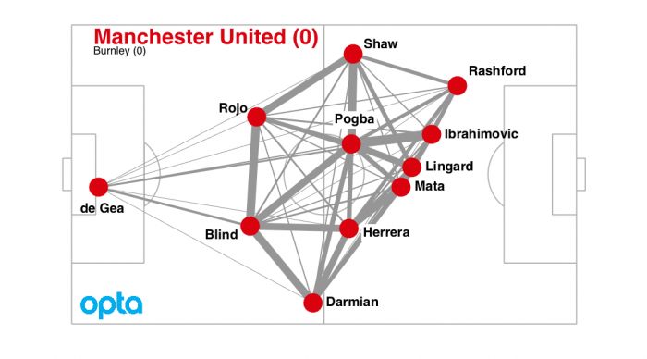
Passing
Passing Networks
Source: https://soccermatics.medium.com/decentralised-football-is-more-effective-than-focusing-on-one-or-two-players-c197216ac2b8; https://tactical-times.com/thomas-muller-resurgence/

Slide 26
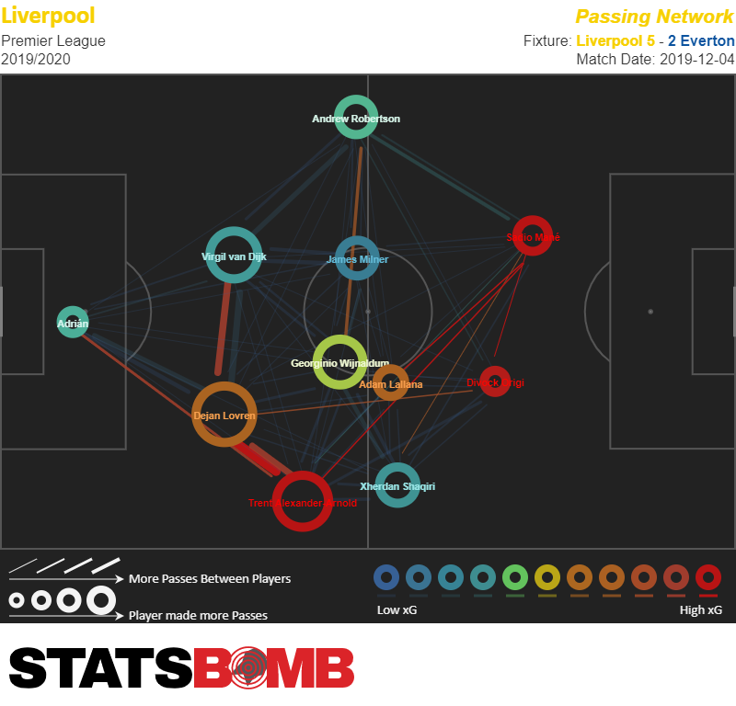
Passing
Passing Networks + value of possessions featuring various networks
Source: https://fbref.com/en/statsbomb; https://statsbomb.com/2018/08/explaining-xgchain-passing-networks/

Slide 27
More On This Topic
Our guest speaker will talk more analyzing passing data

Slide 28
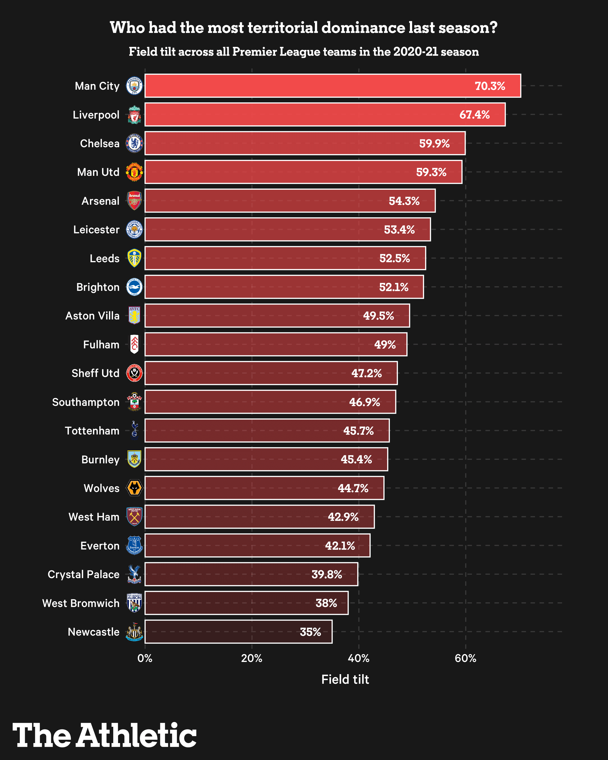
Field Tilt and Territorial Dominance
Field tilt: % of total team + opponent passes in “final third” done by team
Source: https://theathletic.com/2730755/2021/07/28/the-athletics-football-analytics-glossary-explaining-xg-ppda-field-tilt-and-how-to-use-them/

Slide 29
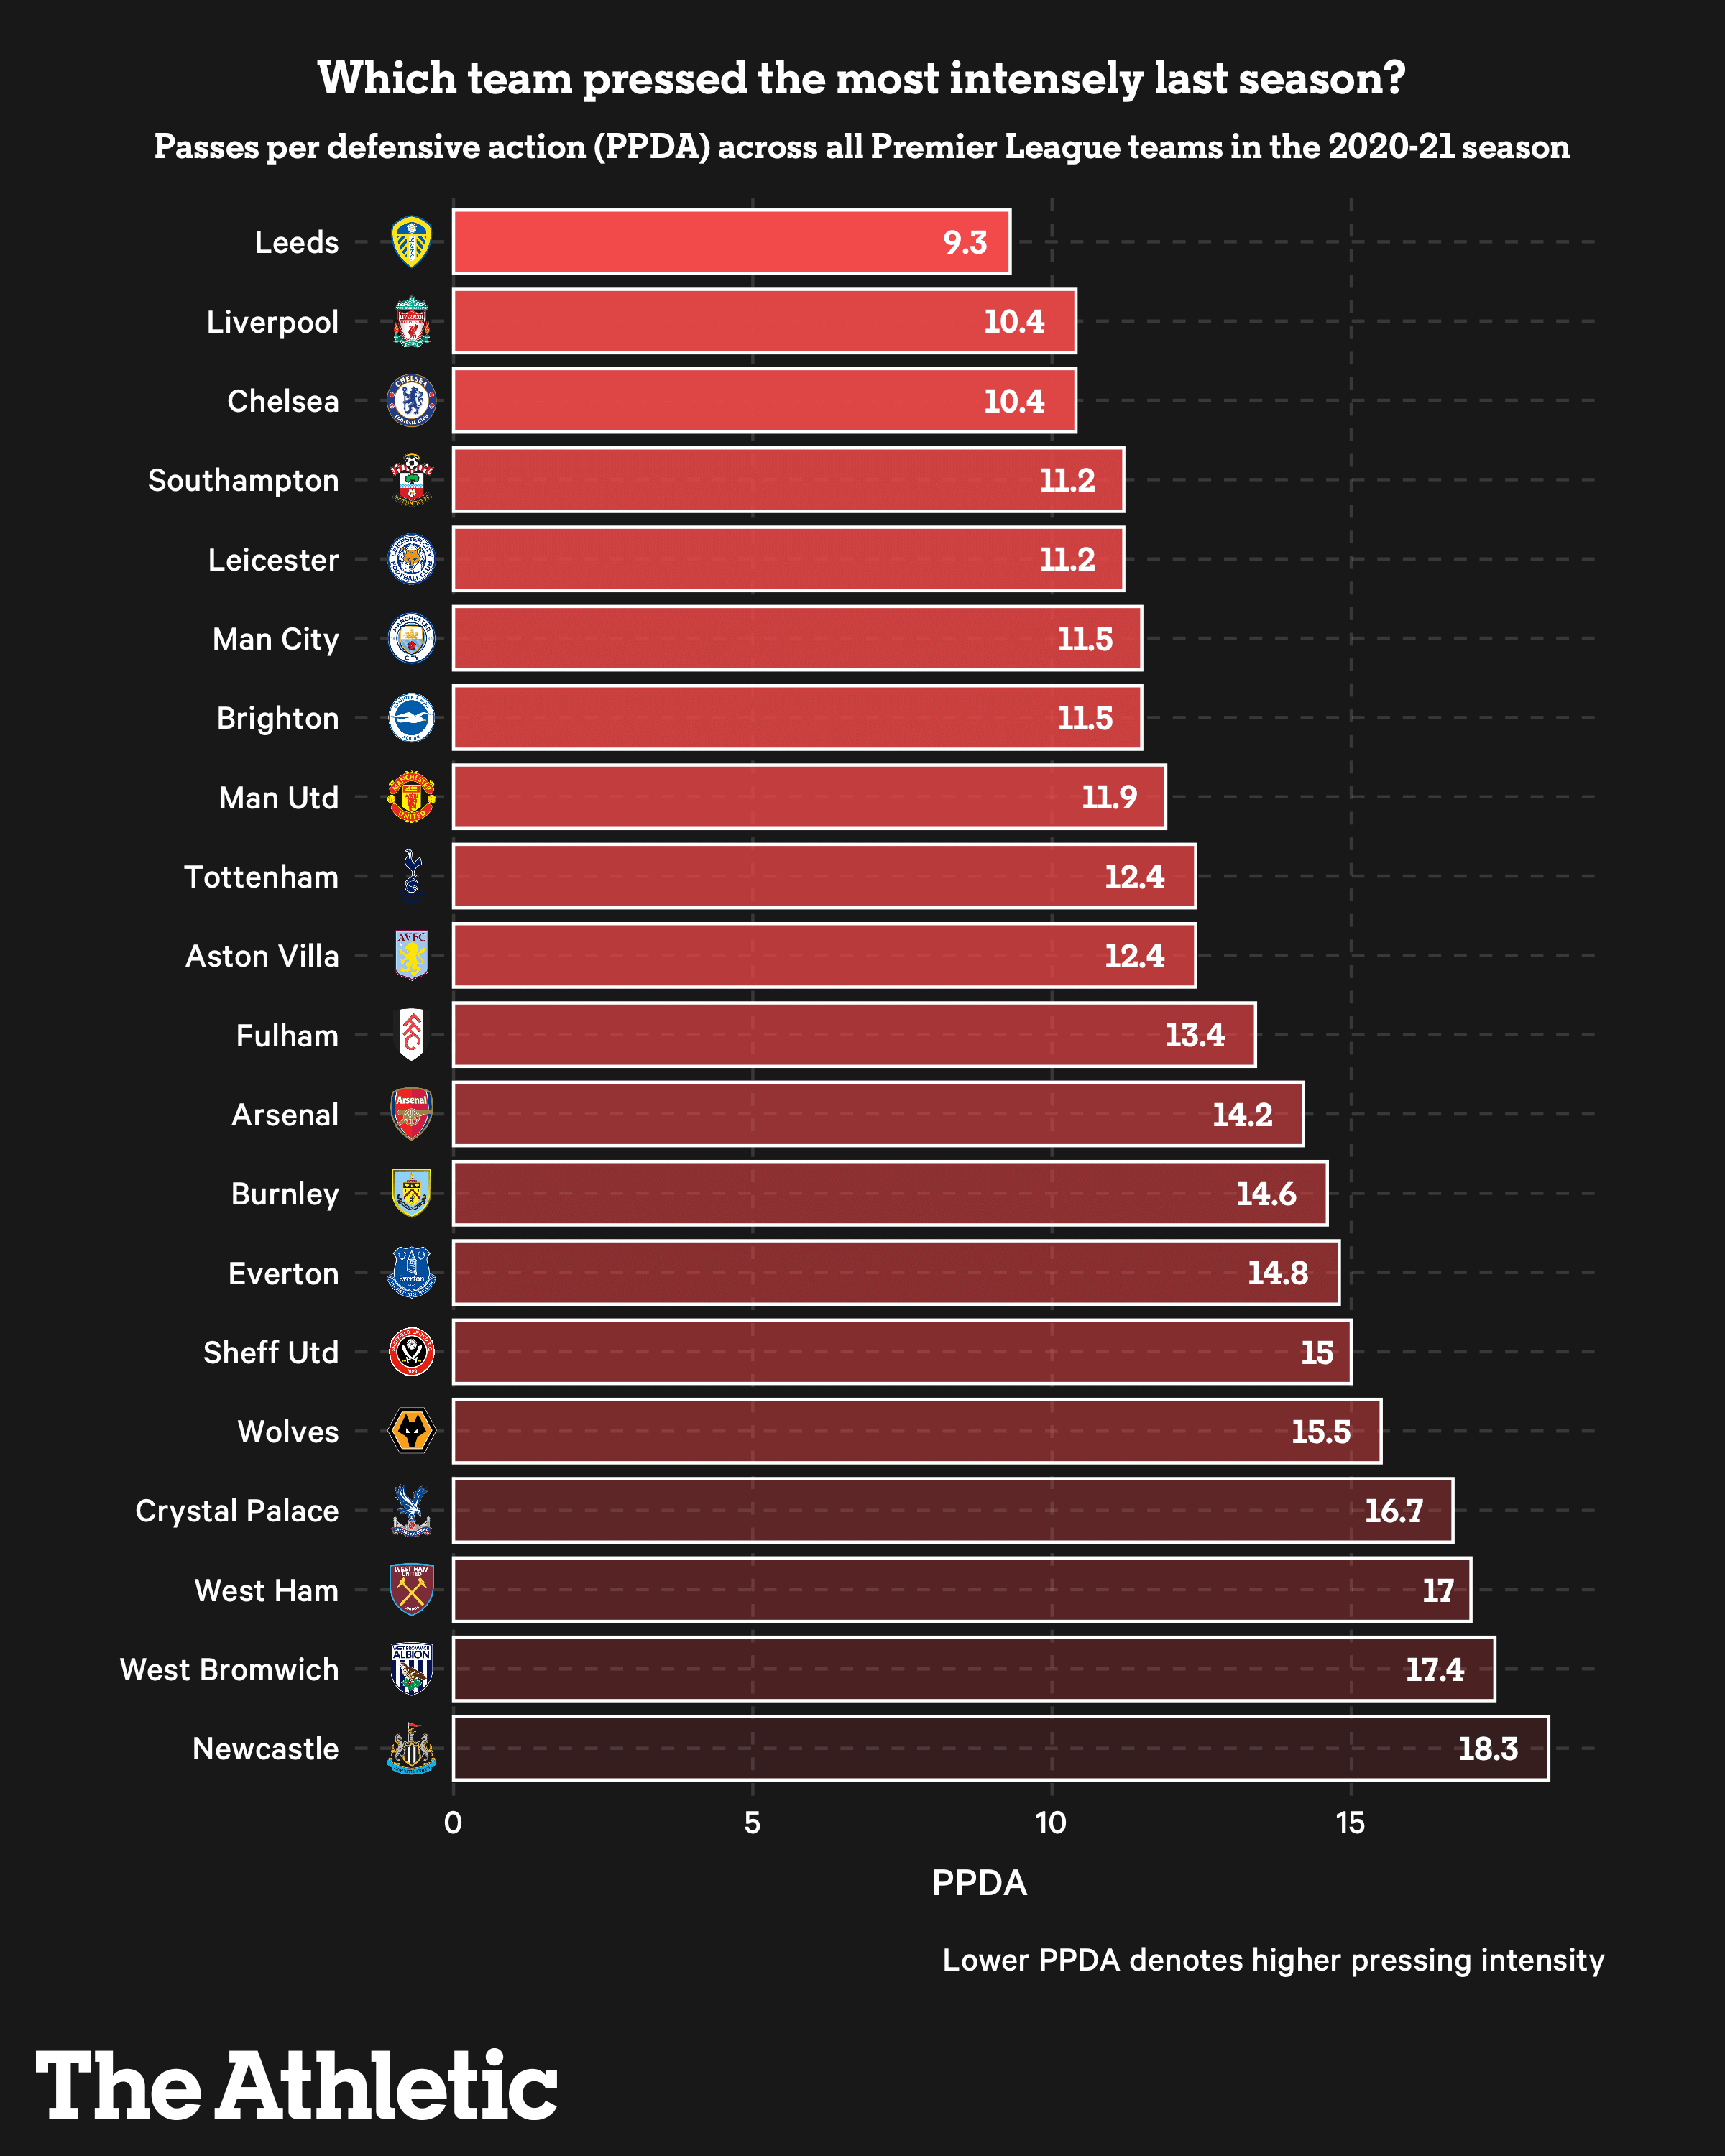
DE-FENSE!
How aggressive are defenses? Passes per defensive action (PPDA)
Source: https://theathletic.com/2730755/2021/07/28/the-athletics-football-analytics-glossary-explaining-xg-ppda-field-tilt-and-how-to-use-them/

Slide 30
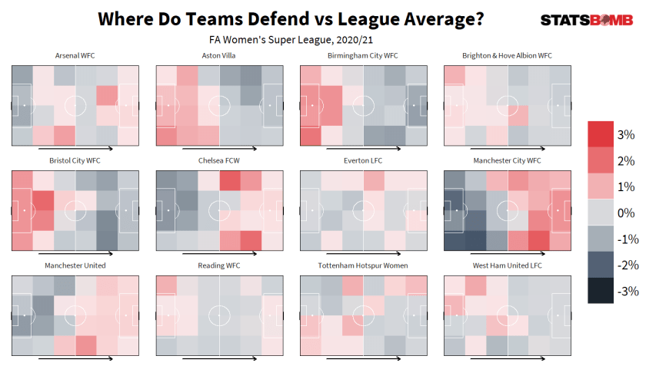
DE-FENSE!
Defending zones, where teams commit defensive actions
Source: https://statsbomb.com/2021/10/statsbomb-release-free-2020-21-fa-womens-super-league-data-updated-r-guide/

Slide 31
Player Evaluation
Radar charts
More to come

Slide 32
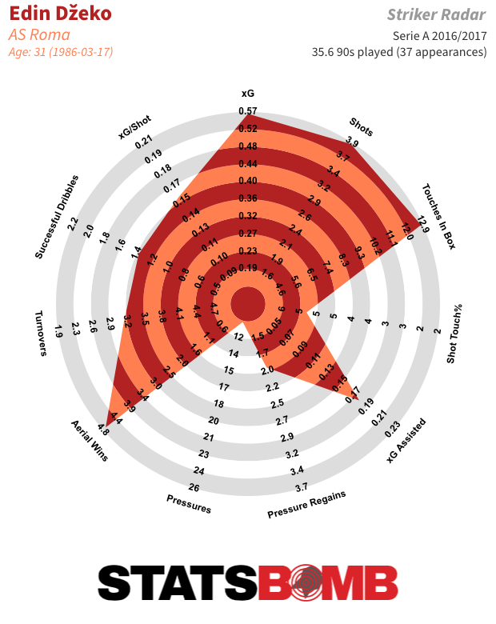
Player Eval: Radars
Radar Charts from Statsbomb
Let’s break one of these down…
Limitations?
Source: StatsBomb

Slide 33
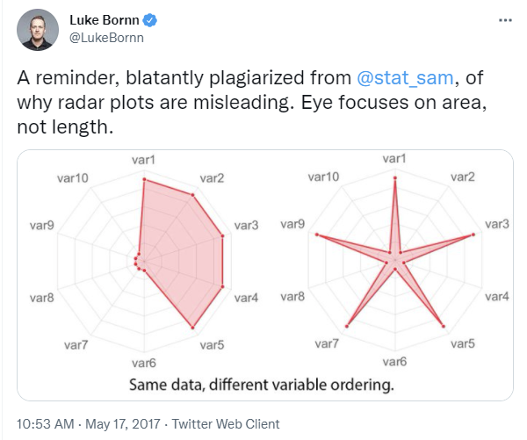
Player Eval: Radars
Radar Charts from Statsbomb
Limitations?
Source: StatsBomb

Slide 34
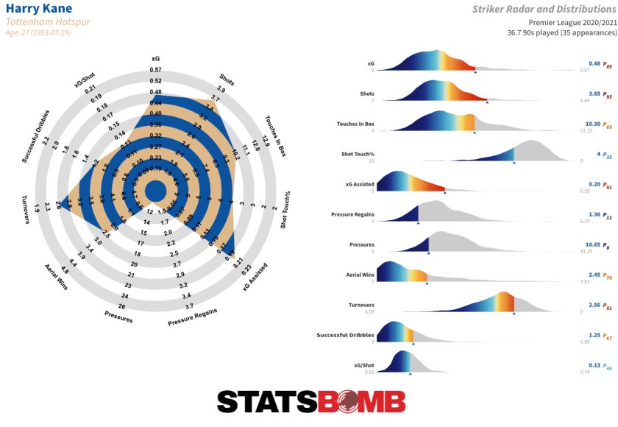
Player Eval: Radars
Radar Charts from Statsbomb
Source: StatsBomb

Slide 35
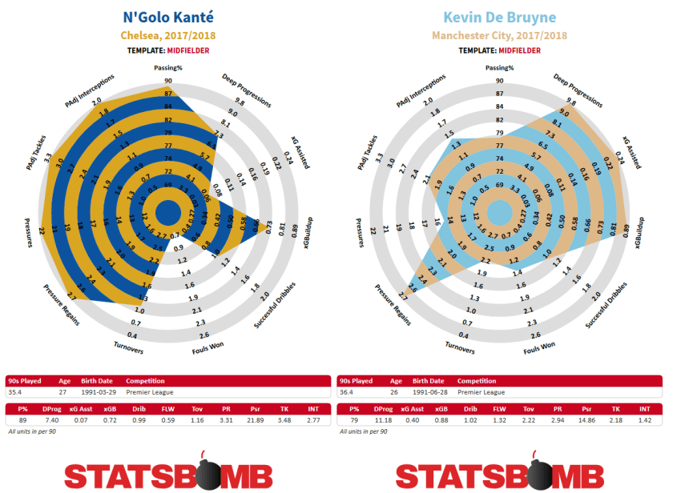
Player Eval: Radars
Source: StatsBomb

Slide 36
More On This Topic
Our guest speaker will talk more about player eval

Slide 37
A Brief Word on Soccer and Racism

Slide 38
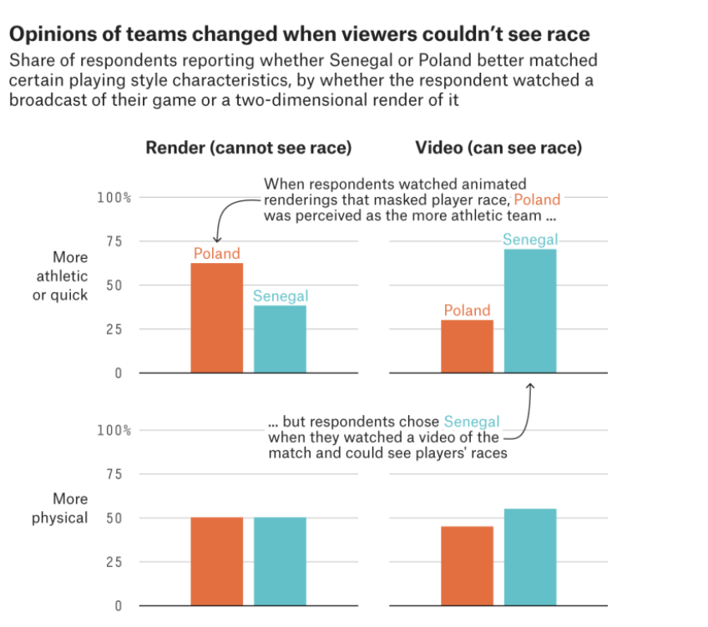
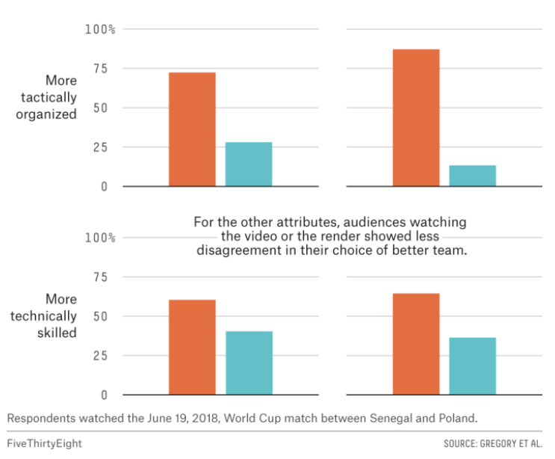
Racial Stereotypes in Soccer (Broadcasting, Scouting)
Source: https://fivethirtyeight.com/features/soccer-looks-different-when-you-cant-see-whos-playing/

Slide 39
More Resources

Slide 40
More Resources
Books
The Numbers Game (Anderson and Sally)
Soccermatics (Sumpter)
Companies/Blogs/Video Series
Opta
Statsbomb (check out their Academy blog posts; also has some public data!)
https://statsbomb.com/2021/10/statsbomb-release-free-2020-21-fa-womens-super-league-data-updated-r-guide/
Friends of Tracking on YouTube
FiveThirtyEight.com, Soccer tag
Programming
@FC_rstats, shaker and worldfootballR package
@FCPython, mplsoccer package
A million online resources, analysts, etc. Build trusted network as you would with other sports.

Slide 41

Thanks!
Questions? zbinney@emory.edu, @binney_z on Twitter

